Slide 1
Solving Wordle with CSP
A constraint programming with LLM approach

Slide 2
Agenda
What is Wordle ?
Some keywords
Constraint Solver
Hybrid Solver
Possible Improvements
Conclusion
What's on the menu ?

Slide 3
What is Wordle ?

Slide 4
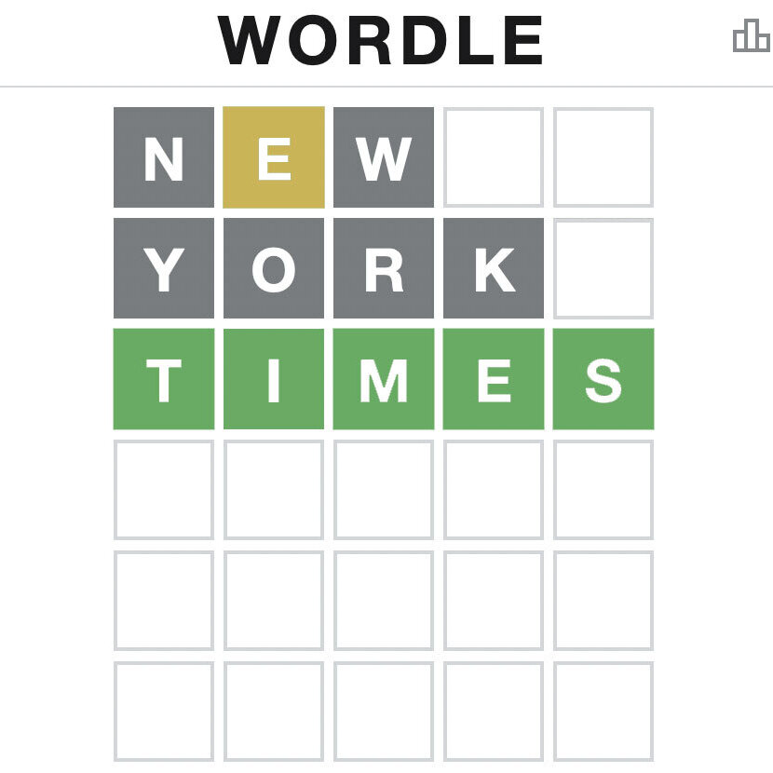
What is wordle ?
A popular single player word guessing game
Created by the New York Times
Simple rules :
Gray - letter not in word
Yellow - in word but wrong position
Green - in word and right position
Perfect problem for Constraint Satisfaction Problem (CSP) and LLM application
✅

Slide 5
Some Keywords

Slide 6
Keywords
Constraint Satisfaction Problem (CSP):
A computational problem defined by a set of variables, domains, and constraints that must all be satisfied simultaneously.
Heuristic (Computer science):
A heuristic is an approach to problem-solving that employs a practical method not guaranteed to be optimal or perfect, but sufficient for reaching an immediate, short-term goal or approximate solution.
Large Language Model (LLM):
A Large Language Model is a deep learning model, typically based on a transformer architecture, that uses billions (or even trillions) of parameters to perform natural language processing tasks such as text generation, translation, summarization, and question answering.

Slide 7
Constraint Solver

Slide 8
Constraint Solver - Main process
1 - Constraint possible words
2 - Update heuristic function
Preprocess word dataset
Repeat until target word is guessed
Target word found
4 - Use feedback to update model
3 - Solve the model (make guess)

Slide 9


Constraint Solver - Implementation
🛠️ Technical stack:
Language: Python
CSP Solver: Google OR-Tools
Data processing: Pandas
📊 Dataset:
English word dataset (~16000 5 letter words)
🔢 Model constraints:
Letter constraints (Gray / Yellow / Green)
Heuristic function (maximize):
Word score = Cp * P + Cl * L - Cd * D
P = letter positional frequency
L = letter frequency
D = Nb duplicate letters in word
Cp = Coef. for P
Cl = Coef. for L
Cd = Coef. for D

Slide 10
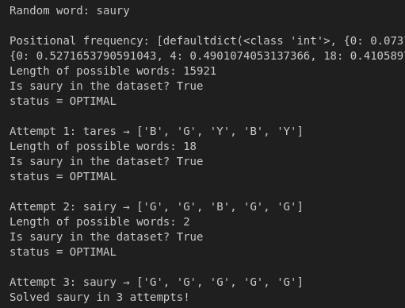
Constraint Solver - Example output

Slide 11
Hybrid Solver

Slide 12
Hybrid-Solver - Solving Process
01
LLM suggest a word
CSP Update Candidates
Start Solver
( Choose target word )
LLM final guess
Repeat until valid word or no more guesses
03
02
LLM Strategic Decision Making with function calling

Slide 13
LLM Strategic Decision Making
Evaluate information gain
LLM Function Calling
Propose a guess
Analyze letter patterns
Language Agent receive possible words
Evaluate information gain
Propose a guess

Slide 14
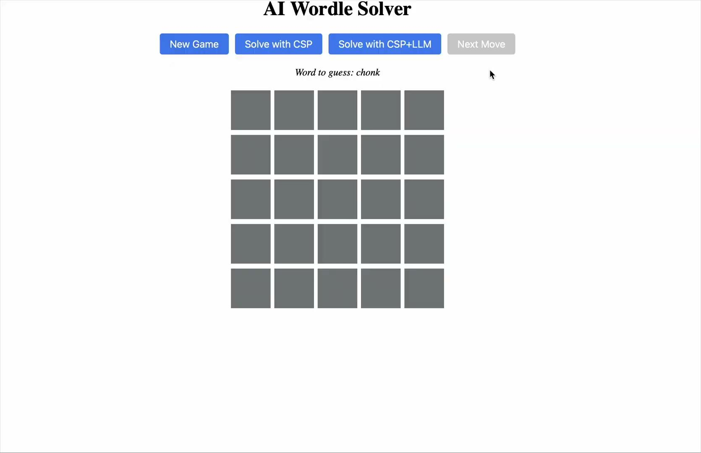

Hybrid-Solver Demo

Slide 15
Possible Improvements

Slide 16
Possible improvements
CSP Solver
Use bigger dataset
Adversarial Filtering / Anti-Worst-Case
Lookahead with Minimax Guessing
Hybrid-Solver
Optimize Information Gain methods
Enhanced LLM Prompting

Slide 17
Conclusion

Slide 18
Thank You!
Any questions ?
Contacts
leon.ayral@epita.fr
gabriel.calvente@epita.fr
cedric.damais@epita.fr
yacine.benihaddadene@epita.fr

